Slide 1
DeepJazz on the Fly
Kyungwoo Hyun
MM 215B – Computer Music Composition by Mari Kimura

Slide 2
References
DeepJazz – Deep Learning Jazz Generation (2015) https://deepjazz.io/
JazzML – Computational Jazz Improvisation (2009) https://github.com/evancchow/jazzml
OMAX – Software Improvisor (2009) http://omax.ircam.fr/

Slide 3
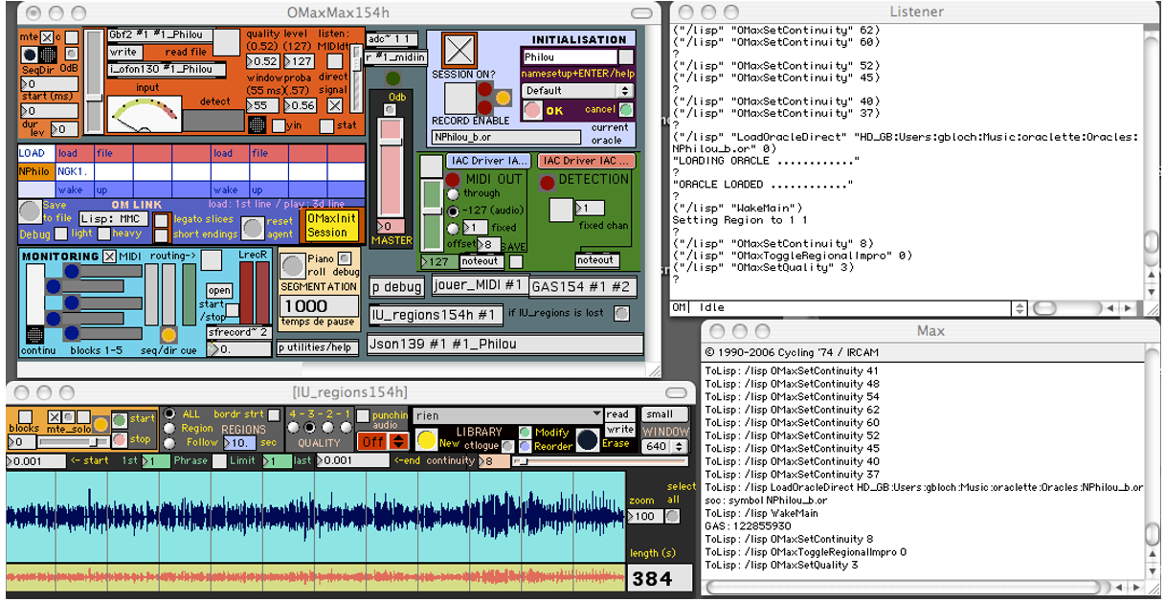
OMAX
Max patch
Lisp

Slide 4
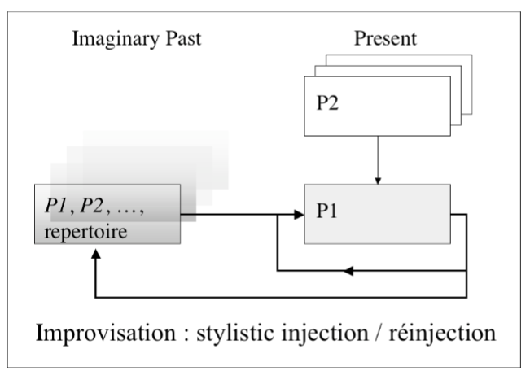
OMAX

Slide 5
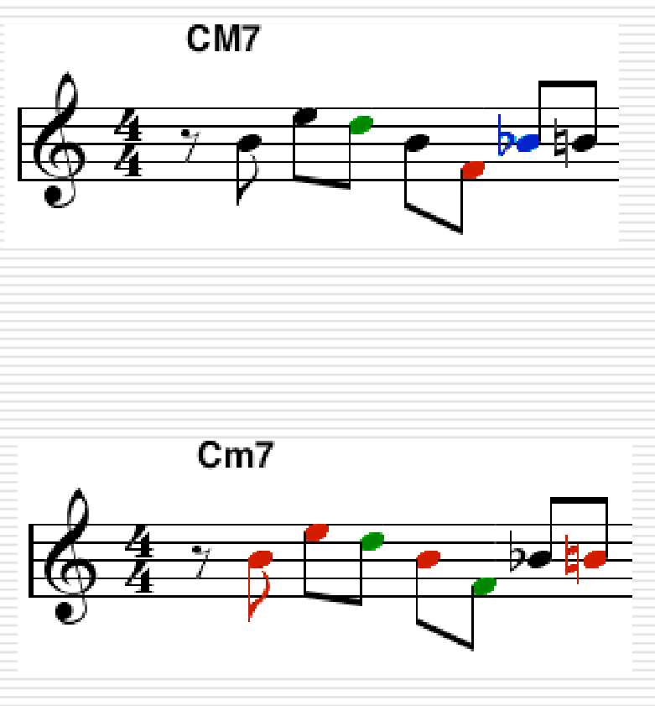
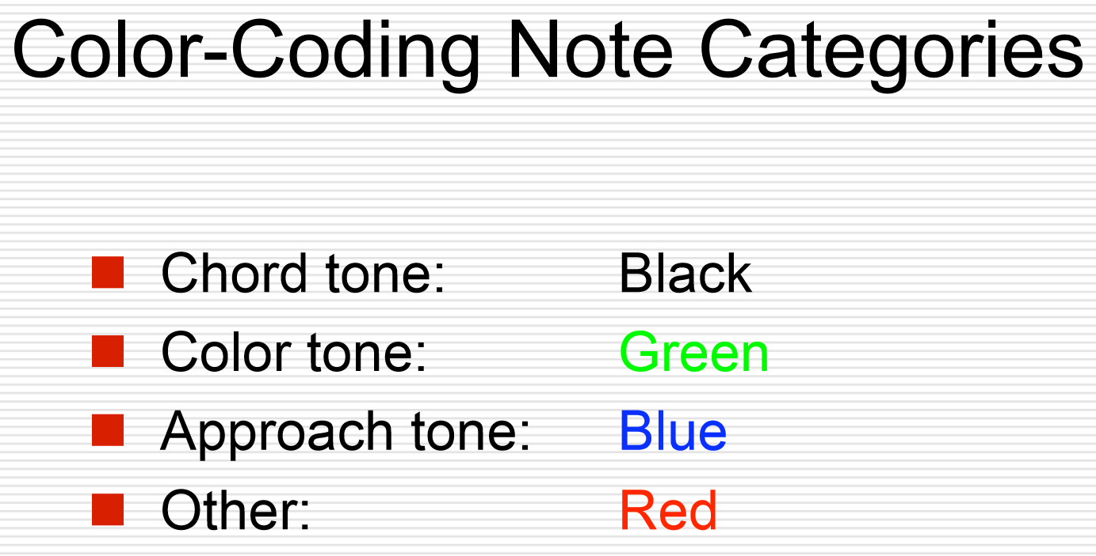
JazzML

Slide 6
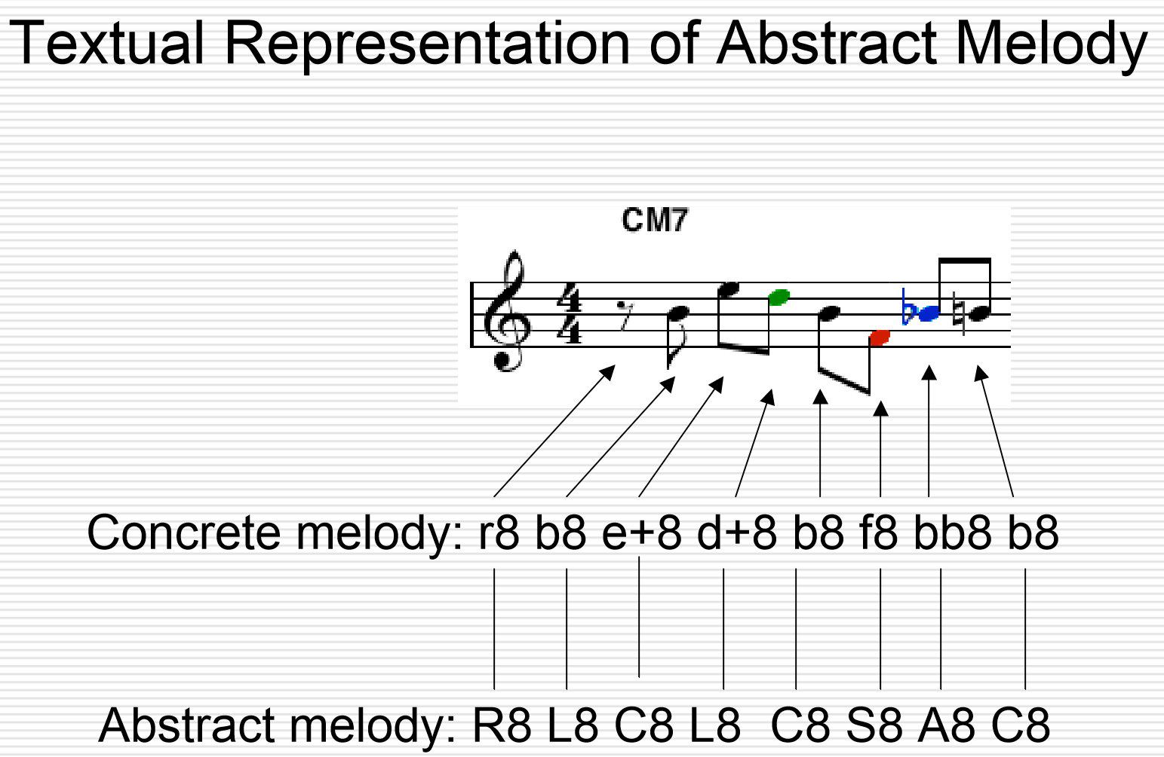
JazzML

Slide 7
DeepJazz on the Fly
Pre-process
using JazzML grammar (chord + memory)
pick the representatives by a measure (/4)
Train (over 1, 128, 1024 epochs)
Predict (Generate)
Post-process (if it’s not good enough, re-generate)
if it’s still not good after 1000 tries, just pick the random
Listen (over UDP / OSC)
from Max patch

Slide 8

DeepJazz Output
Title | Origin | 1 epoch | 128 epochs | 1024 epochs
Ed Sheeran – Perfect (Verse 1)
Ed Sheeran – Perfect (Chorus)
Camila Cabello – Havana (Verse 1)
Pat Metheny – And Then I Knew (Verse 1)
Liszt – La Campanella (1st part)

Slide 9

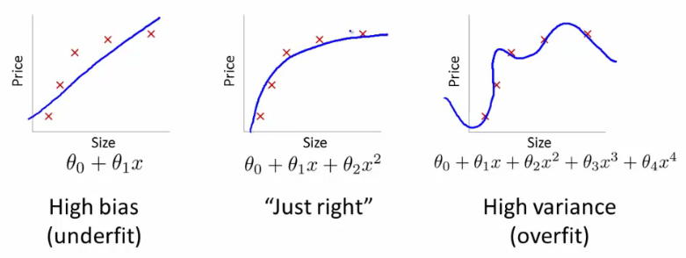
Between Underfitting and Overfitting

Slide 10
Future works
Build the architectures for more genres (not Jazz)
Understand the structure (A-B-A-C, A-A’-A’’)
Integrate with Max

